Slide 1
ONLINE BLOGGING PLATFORM
MENTOR : MR.GUNTI SURENDRA

Slide 2
INTRODUCTION :
An online blogging platform is a website or application that allows users to create and publish blog posts.
There are many different online blogging platforms available, each with its own features and benefits.
To get started with blogging g, you will need to choose a blogging platform and create an account. Once you have created an account, you can start creating blog posts.
Once you have published a blog post, you can share it on social media or other websites. You can also promote your blog by submitting it to directories and search engines.

Slide 3
BENEFITS OF ONLINE BLOGGING PLATFORM :
Share your thoughts and experiences. A blog is a great way to share your thoughts, ideas, and experiences with others. You can write about anything you want, from your personal life to your professional experiences.
Connect with others. Blogging can help you connect with others who share your interests. You can comment on other blogs, participate in forums, and attend blogging events.
Build an audience. If you blog consistently and provide valuable content, you can build an audience of loyal readers. This can be a great way to promote your business or brand, or simply to connect with other people who share your interests.

Slide 4
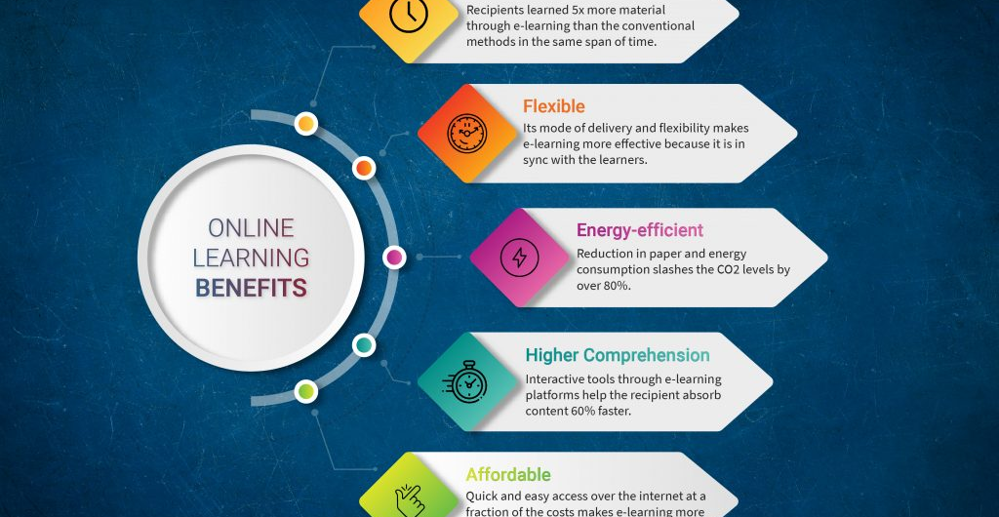

Slide 5
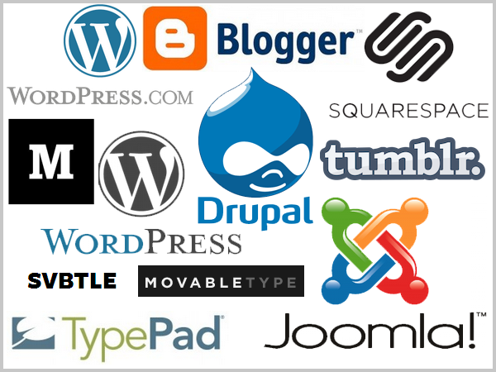
KEY MODULES AND FEATURES :
User Registration and Profiles
Content Creation
Post Management
Comments and Interactivity
User Engagement
Search and Navigation
Design and Customization
Mobile Responsiveness

Slide 6
ADVANTAGES OF ONLINE BLOGGING PLATFORM :
Ease of Use: Most online blogging platforms are user-friendly and require little to no coding or technical expertise, making it accessible to a wide range of users.
Quick Setup: You can create a blog within minutes by signing up on a blogging platform, selecting a template, and starting to write.
Cost-Effective: Many platforms offer free plans with basic features, making it a cost-effective option for individuals and small businesses.

Slide 7
DISADVANTAGES OF ONLINE BLOGGING PLATFORM :
Limited Customization: Free or low-cost plans often have limitations on design and functionality, limiting your ability to create a unique blog.
Lack of Control: You have limited control over the underlying infrastructure and may be subject to the platform's terms of service.
Branding and Domain Restrictions: Free plans may include the platform's branding in your domain name or limit your choice of a custom domain.

Slide 8
FEEDBACK :
We have circulated a feedback form and collected feedback from many customers. These are some of the main questions or aspects we asked from the customers.

Slide 9
QUESTIONS
Can I make money from my blog on these platforms?
What is an online blogging platform?
What are some popular online blogging platforms?

Slide 10
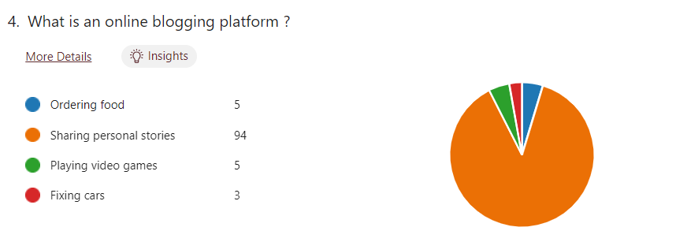
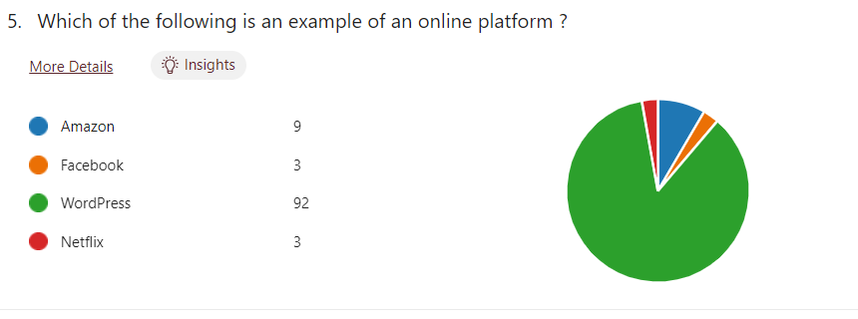

Slide 11
CONCLUSION :
As a team, we are actively working to finish this project. We intend to create a website that is efficient and has a user-friendly front-end interface. We are sure we can create a more user-friendly website. We guarantee that our consumers will experience an unprecedented degree of satisfaction.

Slide 12
